Slide 1
CSE 3100 Exam 2 Review

Slide 2
Forking
You will NOT have to call fork() on the exam
fork() returns a process ID
In the child, process ID is 0 (child is not aware it is a child
In the parent, process ID is the child’s process ID in the parent
fork() clones a process
Duplicates address space (stack, heap statics, executable code)
Duplicates file descriptor table
After forking, anything done independently in each process will not occur in the other process
NOTE: Anything that happens in either process occurs independently
Cloned processes are not automatically synchronized to occur in a specific order

Slide 3
Process Death
The parent is expected to reap its child
If the parent dies first, the OS reaps the child
This only occurs when the child finishes running
We use waitpid to reap a process
Waits until the child process terminates until continuing
Parameters: the ID of the child process, the ADDRESS of the exit status integer, and 0
Returns the process ID of the process that died
Note:
If a process is left waiting to read from a pipe, then it will never terminate - VERY BAD
It is good practice to close all necessary pipe ends whenever possible to avoid this state

Slide 4
Pipes
We use pipe() to create a pipe
Input: an array of 2 integers - these will serve as our read file descriptor (index 0) and our write file descriptor (index 1)
Output: A return status (0 for success, -1 for error)
Pipes provide us with a means of communication between processes
We set up our pipes BEFORE we fork
Remember: all file descriptors and memory data are cloned when calling fork, allowing the child process to know what pipes are established by the parent.
Pipes act like containers of water, where bytes serve as drops of water:
We can pour a certain amount of bytes into the write end of a pipe
Those bytes will sit in the pipe until emptied out by the read end of the pipe
For this reason, it is important that we keep a close eye on our buffer size, or alternatively, the number of bytes written to and read from the pipe

Slide 5
Redirecting Pipes
We use dup2 to redirect pipes
Parameters: the file descriptor that we are redirecting to, the file descriptor that we are redirecting
Access these values from the array which we passed to pipe()
How dup2 works:
For a call to dup2(fd1, fd2)
dup2 closes fd2
dup2 then scans the file descriptor table from top to bottom until it finds a closed file descriptor
This should be the file descriptor of fd2
dup2 then redirects fd1 to fd2, so we can now read from fd2 to read what was contained in fd1
NOTE: we still need to close fd1
RECOMMENDATION: draw your pipes and file descriptors to avoid bugs

Slide 6
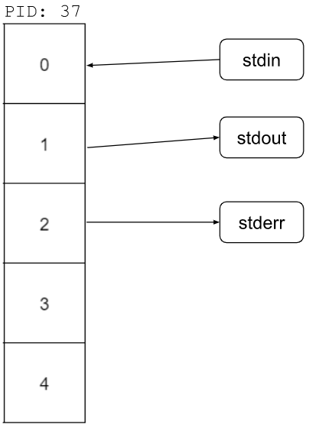
Dup2 Diagram

Slide 7
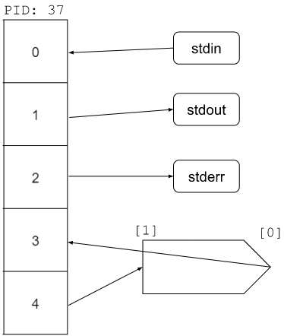
pipe()

Slide 8
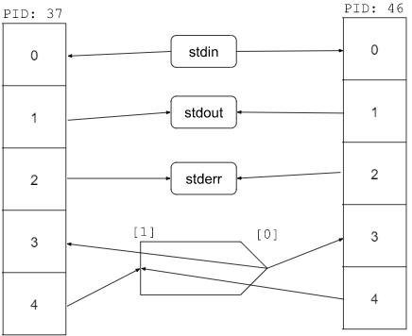
fork()

Slide 9
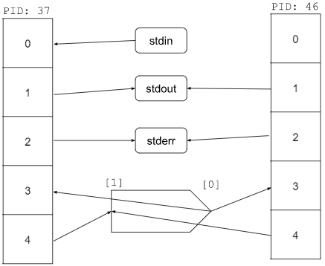
Child: dup2(3, 0)

Slide 10
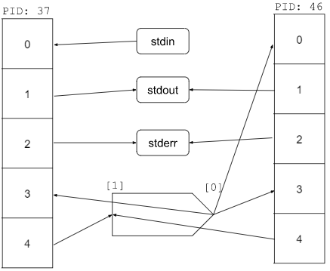
Child: dup2(3, 0)

Slide 11
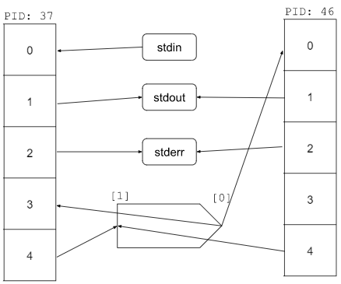
Child: close(3)

Slide 12
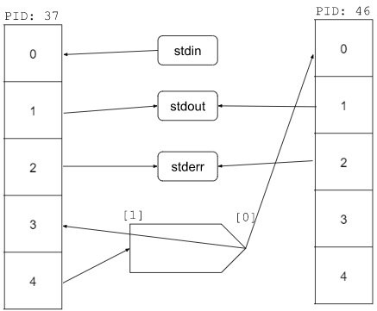
Child: close(4)

Slide 13
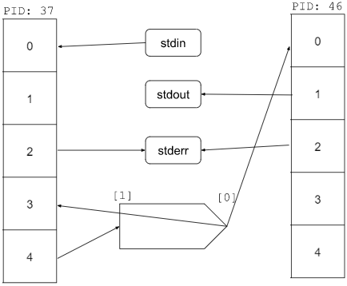
Parent: dup2(4, 1)

Slide 14
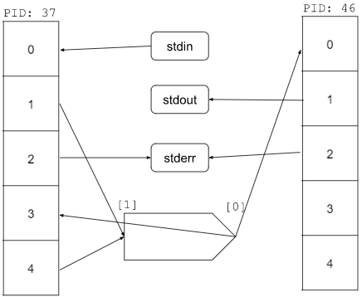
Parent: dup2(4, 1)

Slide 15
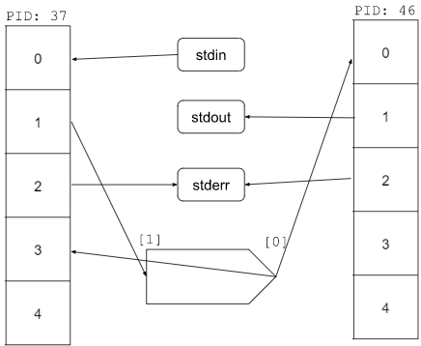
Parent: close(4)

Slide 16
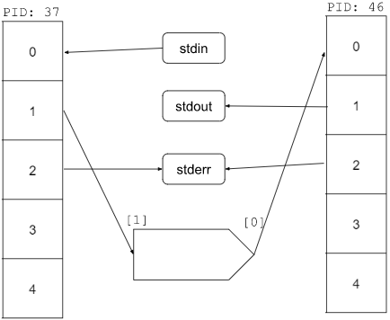
Parent: close(3)

Slide 17
What does this system do?

Slide 18
What does this system do?
We have redirected the output of the parent to the write end of the pipe
We also have redirected the input of the child to the read end of the pipe
A call to printf() in the parent will write to the child
A call of scanf() in the child will read what was written by the parent

Slide 19
Read/Write to Pipes
Read:
Takes the file descriptor, the buffer to read into, and a number representing the number of bytes being read
Outputs the number of bytes read
The result of read is stored in the buffer (not the return value)
Write:
Takes the file descriptor, the buffer containing what is being written, and the number of bytes being written
Outputs the number of bytes written
Note: a buffer can be an array or the address of any scalar type - AS LONG AS IT IS A POINTER
Common issues: wrong buffer size, misuse of strlen() if writing to a file descriptor, misuse of sizeof when finding the size of the individual items read

Slide 20
Re-emphasis
The third parameter in read() and write() is the size in bytes of the item being written-to/read-from a file descriptor
char buff[10];
write(fd, buff, 10*sizeof(char));
// or...
int buff;
read(fd, &buff, sizeof(int));

Slide 21
Macros
Quick notes on macros:
Macros are defined with #define ..., and are often noted with all capital letters
Example:
#define MAXLEN 1000
Macros REPLACE the location where they are referenced in the code
They are NOT variables
Therefore, they DO NOT have an address

Slide 22

Common Mistakes
What’s wrong with this code?
How do we fix this?

Slide 23
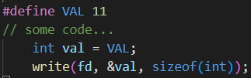
Common Mistakes
Correct
Approach

Slide 24

Common Mistakes
What’s wrong with this code?
How do we fix this?

Slide 25

Common Mistakes
Correct
Approach

Slide 26
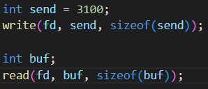
Common Mistakes
What’s wrong with this code?
How do we fix this?

Slide 27
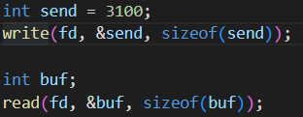
Common Mistakes
Correct
Approach

Slide 28

Common Mistakes
What’s wrong with this code?
How do we fix this?

Slide 29
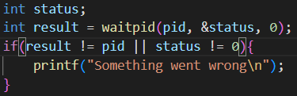
Common Mistakes
Correct
Approach

Slide 30
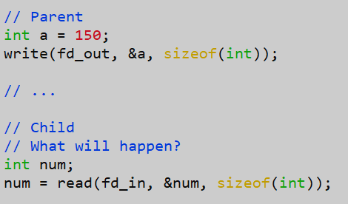
Common Mistakes
What’s wrong with this code?
How do we fix this?
Notes:
What happens if bytes is not 4?

Slide 31

Common Mistakes
Correct
Approach
Notes:
What happens if bytes is not 4?

Slide 32
Exec
The exec family of functions calls a shell command based on the parameters that are passed in
This differs from function to function
Refer to the man pages for information on a specific function
Calling exec completely guts your process
None of your code after the exec call should occur
The file descriptors are what remains
We can use pipe redirections to stdin and stdout to write to a process running an exec call and read the result
Remember: set up pipes correctly BEFORE calling exec

Slide 33
End of a Pipe
If all file descriptors referring to the write end of a pipe have been closed, then an attempt to read from the pipe will see end-of-file, and read() will return 0
This way the read end of the pipe knows when to stop reading from the pipe
From here we can close the read end so that it isn’t trying to read for eternity, unable to die

Slide 34
An example program
Check the Exam 2 Review Session Folder in HuskyCT
Download digits.c and setup your environment
We will code along together
Solutions will be posted after the review session

Slide 35
Extra Notes:
Again, DO NOT CALL FORK
It is highly recommended that you run your code locally rather than submit to gradescope to test your code
It takes a long time for gradescope to run
PLEASE make sure your code compiles
Recommendation: each time you have compiled code, copy it into a notepad so that if your changes are unrecoverable, you always have compiled code to submit

Slide 36
Questions?

Slide 37

Exam Review Feedback
Please give us feedback to improve future exam reviews!
(also we need feedback to get credit as TAs, thank you! :D)

